Slide 1
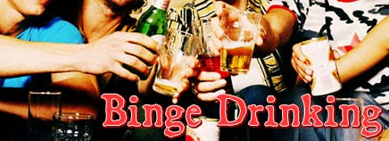
Another
Night
WASTED
Binge drinking in Australia - especially teenagers.
Rearne Goodwin S00061466 and Nicole Hoare S00032126
Notes:
People have been drinking alcohol for tens of thousands of years, as part of various religious ceremonies, as a painkiller, and for socialisation and fun. It is the most commonly used and socially acceptable recreational drug in Australia. Alcohol consumption is a problem for the whole community. It impacts significantly on children and young people’s sense of safety and wellbeing, and can lead to poor role modelling. Risky drinking by young people is also of concern. Brain development is still occurring throughout adolescence and into early adulthood. Emerging evidence indicates that alcohol may have an effect on the development of memory, decision making and emotions, which can lead to problems with learning, problem solving and mental health.

Slide 2
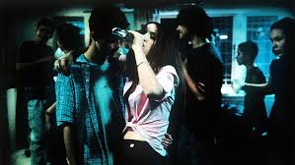
What is Binge Drinking?
Binge drinking means drinking heavily on a single occasion, or drinking continuously over a number of days or weeks.
A person who binge drinks may usually have restrained drinking habits, but sometimes when they drink, they don’t hold back. Alternatively, someone may not necessarily set out to drink a lot, but may be unsure of their limits, resulting in drinking too much over a short period of time.
People can also be more likely to binge drink if they feel peer pressure to do so, or if they’re feeling awkward or uncomfortable at a party.
Notes:
Drinking alcohol is the most common type of drug use in Australia. Alcohol is so widely used that many people don’t think of it as a drug and may not realise that it can be harmful. As a result, they may drink too heavily at times or binge drink.
Drinking to the point where the more severe negative effects of drinking alcohol occur, especially intentionally, is called binge drinking. Because being drunk stops a person thinking clearly and acting sensibly, a person who drinks to excess may put themselves and others at risk from injury due to falls, physical assault and dangerous behaviour. This is why alcohol is closely associated with road accidents, fights, violence, unwanted sexual activity and unprotected sex. Alcohol use has also been found to be associated with suicide and self-inflicted harm.

Slide 3
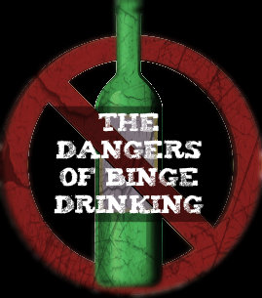
Do You Know the Risks?
Short term effects of binge drinking
If you drink large amounts you're likely to experience a number of physical effects, including:
hangovers
nausea
shakiness
vomiting and memory loss
injury to yourself or others
alcohol poisoning.
Long-term effects of binge drinking regularly
Continuous heavy drinking over a long period of time can lead to:
physical and psychological dependence on alcohol
significant damage to the brain and liver
risk of cancer of the oral cavity, pharynx, larynx, oesophagus, liver, colon, rectum and breast
possible increased risk of neurological disorders, heart problems
sexual problems (especially male impotency)
risk of emotional and mental health problems developing, such as depression and anxiety
problems at school, work and with relationships
Notes:
Binge drinking can be seriously bad and harmful to your health. It can expose you to injury or to unnecessary risks to yourself and others. As well as having adverse short-term effects, binge drinking can also cause long-term effects on your health and wellbeing.
Alcohol is a major cause of injury and death among young people. When you’re drunk, you’re more likely to put yourself in risky situations, like getting into a car with someone who’s been drinking, or being the perpetrator or victim of violence.

Slide 4
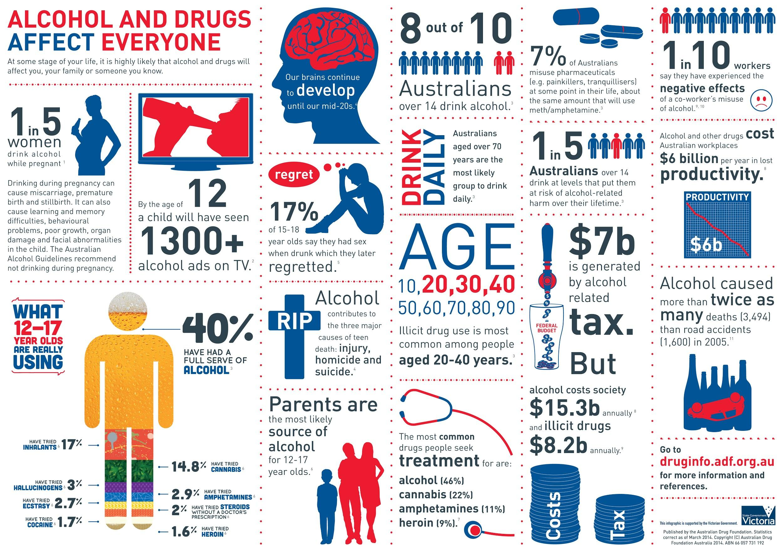
Notes:
Alcohol and drugs affect everyone. At some stage in your life it is highly likely that alcohol and drugs will affect you, your family or someone you know.

Slide 5
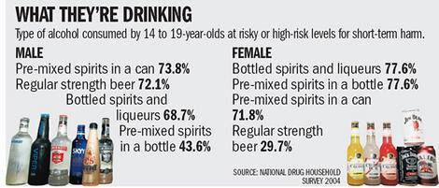
Do you know WHO in Australia is likely to Binge Drink?
Some facts about the prevalence of teenage drinking:
About 40% of 14-19 year olds report drinking alcohol at levels that risk harm in the short term
By age 14, about 86% of students have tried alcohol
By age 17, 70% of students had consumed alcohol in the month prior to the survey
Fact Sheets to Download
PDF- Are Australian Teenagers Drinking
PDF- Teenagers and Binge Drinking
Notes:
The National Institute on Alcohol Abuse and Alcoholism defines binge drinking as a pattern of drinking that brings a person's blood alcohol concentration (BAC) to 0.08 grams percent or above. This typically happens when men consume 5 or more drinks, and when women consume 4 or more drinks, in about 2 hours.

Slide 6
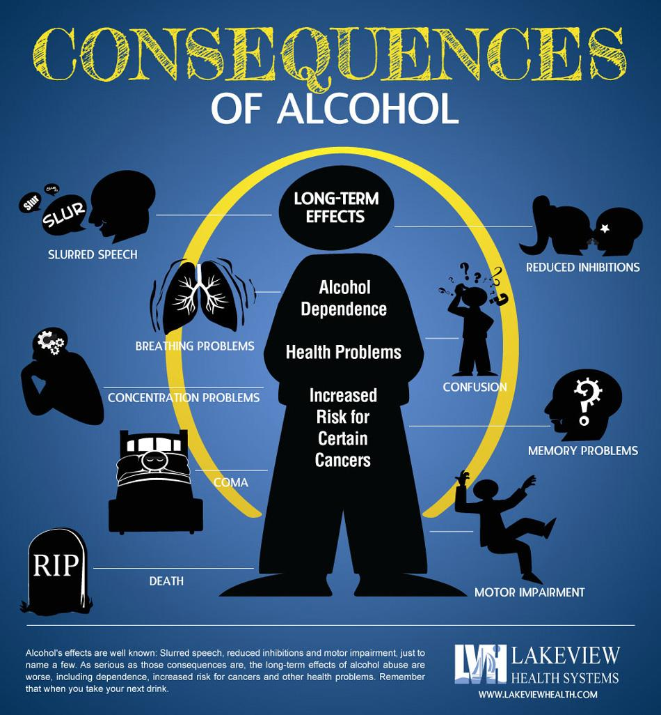
Some facts about the Consequences
On average, 1 in 4 hospitalisations of 15–25 year-olds happen because of alcohol.
70 Australians aged under 25 will be hospitalised due to alcohol-caused assault in an average week.
Four Australians aged under 25 die due to alcohol-related injuries in an average week.
1 in 2 Australians aged 15–17 who get drunk will do something they regret.
Notes:
Consequences of Underage Drinking
Youth who drink alcohol are more likely to experience
School problems, such as higher absence and poor or failing grades.
Social problems, such as fighting and lack of participation in youth activities.
Legal problems, such as arrest for driving or physically hurting someone while drunk.
Physical problems, such as hangovers or illnesses.
Unwanted, unplanned, and unprotected sexual activity.
Disruption of normal growth and sexual development.
Physical and sexual assault.
Higher risk for suicide and homicide.
Alcohol-related car crashes and other unintentional injuries, such as burns, falls, and drowning.
Memory problems.
Abuse of other drugs.
Changes in brain development that may have life-long effects.
Death from alcohol poisoning.
In general, the risk of youth experiencing these problems is greater for those who binge drink than for those who do not binge drink.
Youth who start drinking before age 15 years are five times more likely to develop alcohol dependence or abuse later in life than those who begin drinking at or after age 21 years.

Slide 7
Do You Feel the Pressure to Binge Drink?
Young people would prefer to face the negative consequences of being drunk than the social exclusion associated with staying sober.
Those who choose not to drink have to come up with several reasons why they weren’t drinking.
To fit in, young people expect that all members of the group will drink to the same level of intoxication. However, exclusion is not just applied to those who don’t drink – it is also a potential consequence for those who drink too much.
Attitudes of young people towards alcohol may be
contributing towards alcohol-related problems.
In a survey of 16 to 17 year-old Western Australian school students:
43.3% reported ‘One of the main reasons I drink is to get drunk’
66.3% reported ‘It is ok to get drunk occasionally’
50.1% reported ‘Drinking is the best way of relaxing’
click image to play clip
Notes:
Why do teenagers binge drink?
As children move from adolescence to young adulthood, they encounter dramatic physical, emotional, and lifestyle changes. Developmental transitions, such as puberty and increasing independence, have been associated with alcohol use. So in a sense, just being an adolescent may be a key risk factor not only for starting to drink but also for drinking dangerously.
Risk-Taking- For some teens, thrill-seeking might include experimenting with alcohol. Developmental changes also offer a possible physiological explanation for why teens act so impulsively, often not recognizing that their actions—such as drinking—have consequences.
Expectancies—How people view alcohol and its effects also influences their drinking behavior, including whether they begin to drink and how much. An adolescent who expects drinking to be a pleasurable experience is more likely to drink than one who does not.
Sensitivity and Tolerance to Alcohol—Differences between the adult brain and the brain of the maturing adolescent also may help to explain why many young drinkers are able to consume much larger amounts of alcohol than adults before experiencing the negative consequences of drinking, such as drowsiness, lack of coordination, and withdrawal/hangover effects. This unusual tolerance may help to explain the high rates of binge drinking among young adults. At the same time, adolescents appear to be particularly sensitive to the positive effects of drinking, such as feeling more at ease in social situations, and young people may drink more than adults because of these positive social experiences.
Personality Characteristics and Psychiatric Comorbidity—Children who begin to drink at a very early age (before age 12) often share similar personality characteristics that may make them more likely to start drinking. Young people who are disruptive, hyperactive, and aggressive—often referred to as having conduct problems or being antisocial—as well as those who are depressed, withdrawn, or anxious, may be at greatest risk for alcohol problems.
Hereditary Factors—Some of the behavioral and physiological factors that converge to increase or decrease a person’s risk for alcohol problems, including tolerance to alcohol’s effects, may be directly linked to genetics. For example, being a child of an alcoholic or having several alcoholic family members places a person at greater risk for alcohol problems. Children of alcoholics (COAs) are between 4 and 10 times more likely to become alcoholics themselves than are children who have no close relatives with alcoholism. COAs also are more likely to begin drinking at a young age and to progress to drinking problems more quickly.
Environmental Aspects—Environmental factors, such as the influence of parents and peers, also play a role in alcohol use. For example, parents who drink more and who view drinking favorably may have children who drink more, and an adolescent girl with an older or adult boyfriend is more likely to use alcohol and other drugs and to engage in delinquent behaviours.
There are many factors that lead to teen drinking. If you ask a teen why they drink you may give you a litany of reasons from:
"I was bored."
"Everyone else does it."
"I like how it makes me feel."
"People like me when I drink because I act different."
"I just wanted to see what it would make me feel like."
"My parents do it so it must not be a big deal."
"It helps me escape reality."
Source: http://pubs.niaaa.nih.gov/publications/AA67/AA67.htm

Slide 8
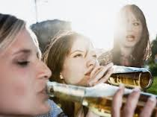
Do you find yourselves in situations where it can be difficult to say no because your friends are doing it and you fear social isolation?
How real is it?
Why do some young people feel the need to pressure their friends into drinking?
Why do others feel the need to go against their better judgement and drink just to fit in?
Notes:
Generate discussion for the students to give own opinion.

Slide 9
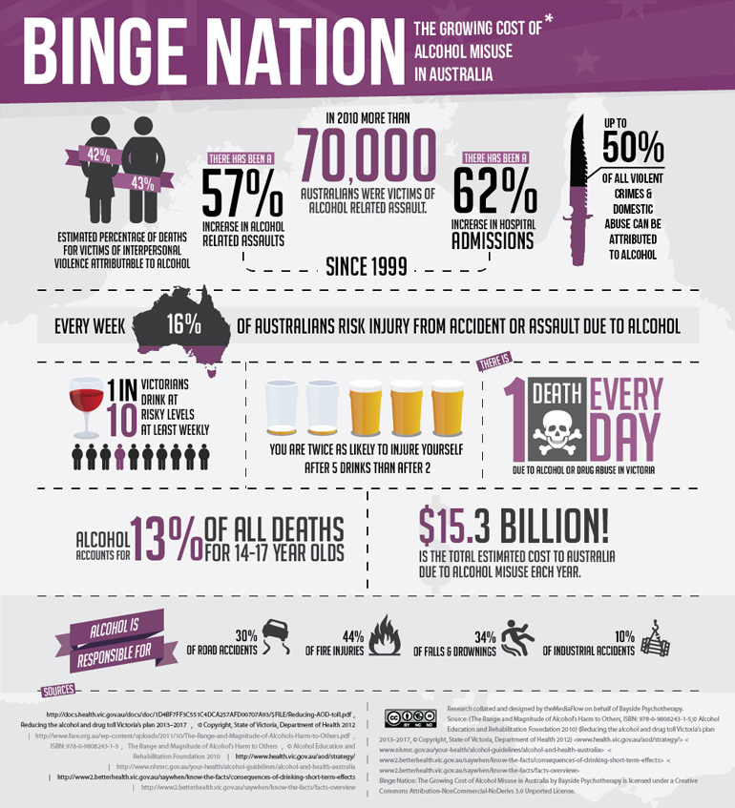
Cultural Influences of Alcohol on Young People
Is Australia a binge nation???
Celebrations
Social/ business functions
Recreational activities
Pubs and clubs
Rural lifestyle
Sporting events
Advertisements
Notes:
Family, peers, school and the media all play a role in influencing the way young people consume alcohol. Forty-six per cent of 12 to 17 year-olds obtain alcohol from their parents and 23 per cent obtain it from their friend. Research indicates, however, that parents and family reduce the impact of these influencing factors where certain processes and structures within the family are present.These include parental modelling, high levels of supervision and monitoring, high family cohesion and cooperation and family support. Alcohol consumption is also influenced by broader factors such as the regulatory framework that governs the availability, price and marketing of alcohol. Recent analysis of the cultural influences on young people’s drinking concluded “Australia’s alcohol culture is shaped by the regulatory framework that governs it. To-date, the framework does not act to adequately protect young people from risky drinking. It is estimated that the elimination of alcohol advertising would reduce monthly alcohol use by adolescents by about 25 per cent and ‘binge-drinking’ by nearly 42 per cent. The recent review into Australia’s taxation system concluded that the current tax arrangements for alcohol were ineffective in addressing the social costs of alcohol consumption and recommended introduction of a volumetric tax to better target these costs.
Social Context of Alcohol in Australia
Alcohol is frequently associated with celebrations in Australia. It is consumed in religious and cultural ceremonies, social and business functions, and also in conjunction with recreational activities. For many Australians “having a drink” is synonymous with relaxation, socialising, and good times. Alcohol use is accepted as an integral part of Australian life and culture and most adults drink alcohol to some degree. Many historical and social factors contribute to the way in which alcohol is used today.
Historically pubs and clubs have served as community meeting places, particularly in rural and remote locations. Consumption of alcohol is viewed as an integral part of a rural lifestyle and is symbolically associated with values such as “self-reliance”, “hardiness”, and “mateship” (Dunn 1998). In many rural areas local hotels and clubs are the primary source of entertainment and provide the main venue for community and sporting groups. In many cases these “watering holes” contribute to community cohesion and identity. They act as an informal setting for airing local concerns and facilitating social interaction. Compared to thirty years ago, alcohol is now more widely available in settings such as cultural and sporting events, and restaurants.
Regular alcohol consumption is considered to be acceptable by the majority (61%) of Australians. Although the Australian population still perceives the drug problems of society to be primarily a result of illicit drug use, there is some recognition of the adverse impact of the harmful use of alcohol on people’s lives in Australia. However recognition of the widespread harms associated with alcohol misuse is limited, generally focused on harms related to acute intoxication, and in many localities there is a perception that illicit drug use is the main problem within the community (Reilly and Griffiths 1998).
In 1998, 14% of Australians surveyed named alcohol as the drug they thought of when people talked about a drug “problem” (AIHW 1999). A survey of 15-17 year olds found that alcohol was considered the third greatest problem faced by youth in this age group, a finding replicated in concurrent surveys of parents of teenagers and young adults aged 18-24 years. Social problems including alcohol-related violence and crime, family disruption, vandalism and destruction of property were identified as increasingly salient and public features of the misuse of alcohol (Shanahan and Hewitt 1999).
The current national alcohol strategy observes that Australia’s drinking cultures are driven by a mix of powerful, intangible social forces, such as habits, customs, images and norms, and other interlocking and equally powerful tangible forces relating to the social, economic and physical availability of alcohol, including promotion and marketing, age restrictions, price, outlets, hours of access and service practices[6] (see Fig. 1). Certainly, there is no single factor that determines why people drink at harmful levels. Health-damaging behaviours related to poor diet, inadequate exercise, cigarette smoking, excessive drinking and illicit drug use appear to be embedded in a complex network of social determinants and risk and protective factors, and behaviours are also mediated by cultural influences.
http://www.dulwichcentre.com.au/alcohol-in-australia.html

Slide 10
Attitudes Towards Teenage Drinking
Watch the clip and discuss:
Can we change the teenage drinking culture
in Australia?
Notes:
Discussion on the topic after watching the clip.

Slide 11
What is the role of alcohol in modern society? Is there too much focus on drinking? Does Australia have a harmful drinking culture?
Analyse and discuss the following advertisement.
The tone of the report
The portrayal of young people
The portrayal of alcohol – ie positive or negative
The particular issues raised
Notes:
Discussion time

Slide 12
Teenage Drinking

Slide 13
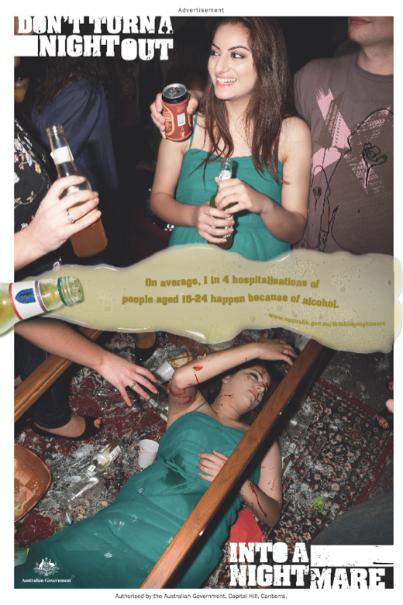
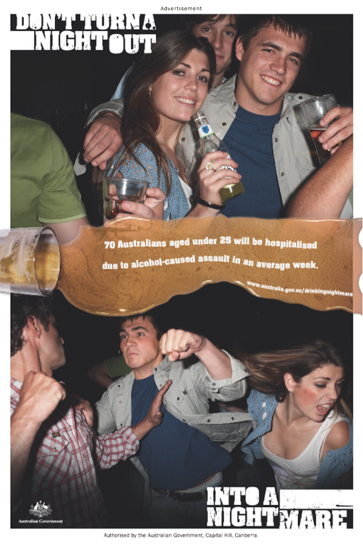
Teenage Drinking Campaigns
Notes:
The National Binge Drinking Campaign and key tagline ‘Don’t turn a night out into a nightmare’ is designed to encourage teenagers and young adults to think about the choices they make about drinking, and particularly the possible negative consequences of excessive alcohol consumption. Excessive drinking can lead to alcohol related harm. This harm may include health problems, injury, violence and social problems including the breakdown of relationships. Specifically, the campaign messages include:
Teenagers aged 15-17 years and young adults aged 18-25 years
Drinking to intoxication can lead to socially unacceptable behaviour and consequences that are regrettable; and
Avoiding drinking to intoxication can have a range of social and health benefits.
Parents of 13-17 year olds
Parents and carers have a role in educating their teenage children about the possible consequences of excessive drinking and in setting clear behavioural boundaries; and
Teenagers generally look to parents and carers for support and direction.

Slide 14
Church Perspective
The Scriptures and the practice of the Church see alcohol as a gift of God. The Psalms praise God who has given us "wine to gladden our hearts," (Ps. 104,15) and the Gospel tells of Jesus providing wine for the wedding celebration at Cana. Every Sunday we gather at the altar where at Jesus’ command we offer and receive wine that has become his blood by the power of the Holy Spirit.
The Scriptures and the Church are also very straight-forward about the abuse of alcohol. St. Paul made it clear in his instructions to the community at Corinth that “drunkards…will not inherit the Kingdom of God.” (1 Cor. 6,10) Instead, we are called “to live sober, upright and godly lives in this world.” (Titus 2,12) Paul opposes the “drinking bouts” which are the work of the flesh, and calls instead for that “self-control” which is the fruit of the Spirit.
Notes:
http://www.newcatholics.org/pg/dioceseAlcoholPolicy.tpl

Slide 15
What does the Bible say?
Ephesians 5:18
And do not get drunk with wine, for that is debauchery, but be filled with the Spirit,
Proverbs 20:1
Wine is a mocker, strong drink a brawler, and whoever is led astray by it is not wise.
Romans 13:13
Let us walk properly as in the daytime, not in orgies and drunkenness, not in sexual immorality and sensuality, not in quarreling and jealousy.
Luke 21:34
“But watch yourselves lest your hearts be weighed down with dissipation and drunkenness and cares of this life, and that day come upon you suddenly like a trap.

Slide 16
Need help?
Where to get help
Your doctor
Police, call triple zero (000)
Ambulance, call triple zero (000)
Emergency department of your nearest hospital
Kids Helpline Tel. 1800 551 800
DirectLine Tel. 1800 888 236 – for 24-hour confidential drug and alcohol telephone counselling, information and referral
Youth Support and Advocacy Service (YSAS) Tel.1800 458 685 – for young people, 24-hour confidential drug and alcohol telephone counselling, information and referral
DrugInfo Tel. 1300 85 85 84 – for information
Action Centre (for young people 25 and under) Tel: (03) 9660 4700
Sexual Assault Crisis Line and CASA Tel. 1800 806 292
National Sexual Assault, Domestic Family Violence Counselling Service (Australia) Tel. 1800 737 732 – free telephone counselling hotline (24 hours, 7 days)
1800RESPECT – for real-time online counselling
Victims of Crime Helpline 1800 819 817
Parentline Tel. 132 289
VFamily Drug Help – for information and support for people concerned about a relative or friend using drugs Tel. 1300 660 068

Slide 17
Do you want to know more?
Links to websites with more information on Binge Drinking:
Tackling Binge Drinking- http://www.tacklingbingedrinking.gov.au/internet/tackling/publishing.nsf
Department of Health- http://www.health.gov.au/internet/main/publishing.nsf/Content/health-pubhlth-strateg-drugs-alcohol-index.htm
Drinking Nightmare- http://www.drinkingnightmare.gov.au/internet/drinkingnightmare/publishing.nsf/Content/home
Headspace- http://www.headspace.org.au/is-it-just-me/find-information/alcohol-binge-drinking
Underage Drinking- http://pubs.niaaa.nih.gov/publications/AA67/AA67.htm
Drinkwise Australia- https://www.drinkwise.org.au/#q=BingeDrinking&r=true
Hello Sunday Morning- https://www.hellosundaymorning.org/
Reach Out- http://au.reachout.com/all-about-binge-drinking
Drug Info- http://www.druginfo.adf.org.au/fact-sheets/the-facts-about-binge-drinking-web-fact-sheet
Stop Underage Drinking- http://stopunderagedrinking.com.au/
Notes:
Bibliography
State Library NSW - http://guides.sl.nsw.gov.au/content.php?pid=552233

