Slide 1
BRANDING – the mythology of brands and its link with consumerism. The buying and selling of teenagers? EDRE623 Assignment 1: D.Cooper (S00125527)

Slide 2
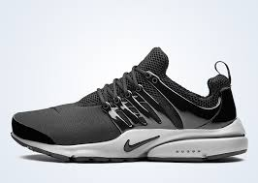
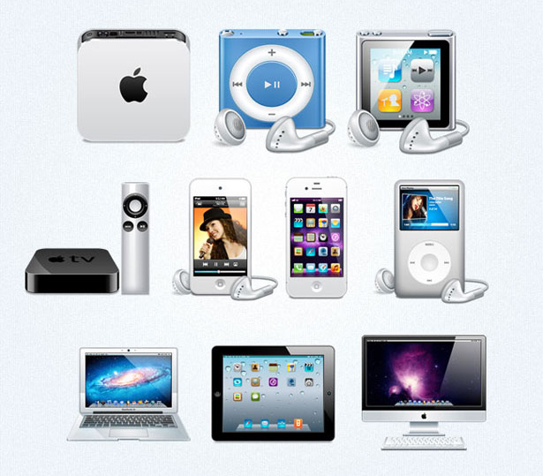
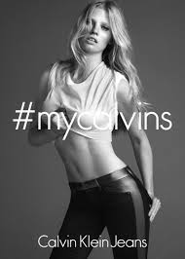
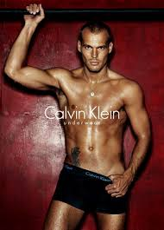
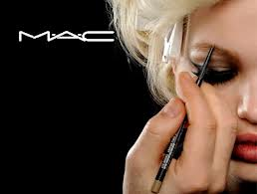

Slide 3
Initial reflection questions
What brands do you see advertised regularly on TV, in magazines and on social media?
What factors influence whether you purchase products from particular brands?
Do you feel pressure to buy particular products/brands? Why/Why not?
Do you believe that branding and marketing has a positive/problematic presence in society for individuals (particularly teenagers)?

Slide 4
Key terminology
Brand:
An idea or image of a product that consumers connect with by recognising a name or logo of the company it is associated with.
E.g. Rip Curl Swimwear
Branding:
The idea or image of the brand is advertised so it is recognised by an increasing number of people. Through effective branding, a good reputation is established that consumers strive to be associated with.
E.g. (See advertisement at: http://www.ripcurl.com.au/shop/girls/swimwear.html ) The branding of Rip Curl Swimwear is associated with physical attractiveness, surf culture and travel to beach destinations.

Slide 5
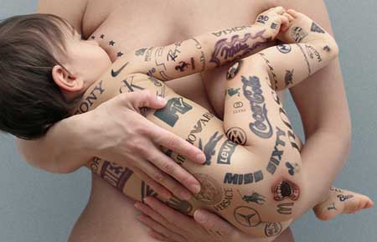
Key terminology continued….
Consumerism:
This is a social and economical ideology which looks at the acquisition and consumption of material goods.
It reflects an attitude that it is desirable to spend one’s money on goods, particularly brands and products that are perceived to increase one’s sense of worth.
All groups of society are consumers (to various extents). Thus, different brands are marketed to appeal to various groups. I.e. children, tweens, teenagers, adults, elderly, male, female.
Johnathan Darby's from his New Solo Show "Generation Y?" Signal Gallery, London Sep 18, 2009.

Slide 6
What does branding and consumerism have to do with teenagers?
Marketing for major brands targets children and adolescents.
For example: major food companies (Coca Cola, Mc Donald's, Subway), Apple technology, major clothing brands such as Rip Curl, Nike, Adidas, Billabong and Supre.
Children in this age group are vulnerable and marketing capitalises on their desire to fit in and be ‘cool’.
Branding and trends define what is ‘cool’ and what a child must wear or own if they want to belong.

Slide 7
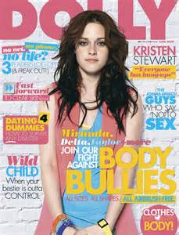
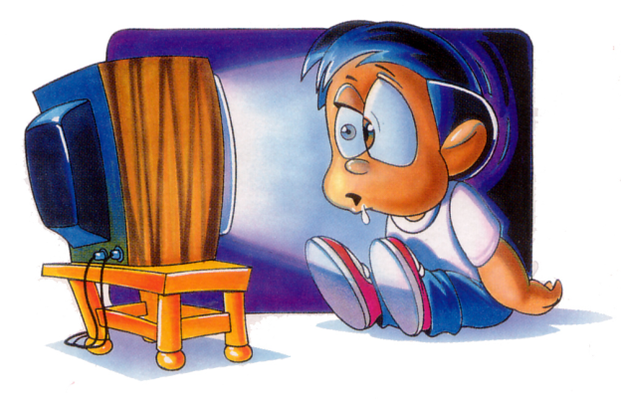
How are teens exposed to branding?
-Television commercials
The advertisements for particular brands often appear during TV programs that children of this age watch.
-Teen magazines
-Advertising on social media
-Their peers
-Product placement in films and TV programs
How then does a child hide from this inescapable influence, or, better still, learn to make critical judgements about the branding they are being exposed to?

Slide 8
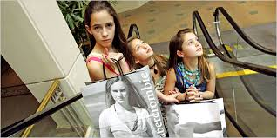
Tween market
Marketers have strategically developed a new target audience to market their products to……. the ‘TWEEN’.
This market group is aged 8-12 and focuses mostly on females.
This is problematic because, by treating these young children as teenagers, tweens are being forced to grow up too quickly.
They are exposed to unhealthy messages about body image, violence and sexuality.
Furthermore, they are naïve and therefore vulnerable to buying into the messages these brands sell them, and are not equipped to make their own judgements about the brands.

Slide 9
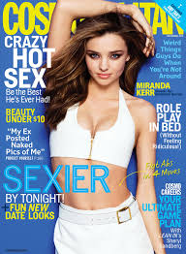
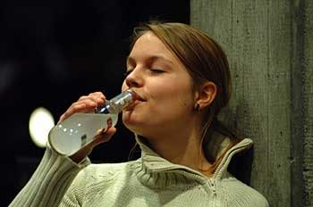
Problematic social/cultural messages from branding
Body image and brand advertising
Brands are selling more than clothing to teens—they’re also selling unhealthy messages
about body image and sexuality.
Advertisement of certain clothing brands are full of images of scarily thin,
beautiful and highly sexualised/provocative young people.
This sends a message that to be popular, cool or happy, a teen must also be physically
beautiful and sexually attractive. This can trigger eating disorders and self-esteem issues
among adolescents, as well as sexuality beyond their age.
How can teens possibly develop healthy attitudes towards sexuality and body image?
Alcohol and Smoking
These days, there are many effective advertisements which educate teens about the risks of smoking. There is less focus on the effects on alcohol.
BUT….brands still target young people, aiming to develop brand loyalties (such as Alco-pop style brands,
and beer/cider advertisements with young people in them).
Advertisements of these brands may be more subtle, where products
appear in teen’s favourite TV shows or in films and are used by teen
characters. In such contexts, drinking and smoking can be associated with being
cool, where characters appear risqué and popular.
This message translates into teen culture and is reflected in their own attitudes
towards drinking.

Slide 10
What influence does it have on shaping teenager’s attitudes, values and behaviour?
It creates an unhealthy personal identity, whereby, young people develop the attitude/belief that they need to define themselves according to popular brands and trends.
This culture suggests that one’s identity and value is formed externally (materialistically) rather than internally.
It breeds a culture of discontent. With these brands preying on society and constantly bringing out new products and trends, people cannot keep up, and thus are constantly focussed on owning the next big thing.

Slide 11
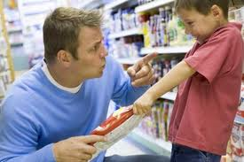
Social impacts
In a society where one’s self worth is reliant upon materialistic goods there are dire social consequences.
A culture of discontent with what one possesses can contribute to mental health issues such as depression, anxiety, body image and self-esteem issues.
Associating with particular brands can create issues of social exclusion and therefore bullying, whereby people are accepted on the basis of possessing particular brands.
Financial pressure to keep up with the endless pursuit of the latest product. Whilst children do not directly experience financial pressure, their parents
undoubtedly experience ‘pester pressure’.

Slide 12
Spiritual Impacts
There is a cultural shift from focus on faith towards focus on the self.
Teens look for brands/material goods to bring meaning and happiness to their lives as opposed to spirituality and faith.
The focus on material goods to form their identity removes their spiritual need for something bigger than themselves to give them hope and meaning (i.e. Faith)
VERSUS

Slide 13
The Catholic Church on consumerism…..
Pope Francis has commented on humans’ overconsumption of material goods and the “culture of waste” that characterises the modern world.
He said: “[W]e are often driven by pride of domination, of possessions, manipulation, of exploitation; we do not ‘care’ for [creation], we do not respect it, we do not consider it as a free gift that we must care for. We are losing the attitude of wonder, contemplation, listening to creation…..”
He also discusses how materialism compromises “human ecology.” The Pope said:
“Men and women are sacrificed to the idols of profit and consumption: it is the ‘culture of waste’….Yet these things become the norm: that some homeless people die of cold on the streets is not news. In contrast, a ten point drop on the stock markets of some cities is a tragedy. A person dying is not news, but if the stock markets drop ten points it is a tragedy! Thus people are disposed of, as if they were trash.”

Slide 14
The Catholic Church on consumerism…(continued.)
Pope Francis suggests some social and ethical commitments that humans should embrace:
-make a serious commitment to respect and protect creation
- to be attentive to every person
-to counter the culture of waste and disposable
-to promote a culture of solidarity and of encounter
These could be addressed in Religious Education classes where students could develop practical strategies to fulfil these commitments.
http://millennialjournal.com/2013/06/06/pope-francis-on-consumerism-environmental-ecology-and-human-ecology/

Slide 15
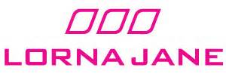
Positive impacts of branding and consumerism upon teenagers
If teenagers are educated about branding and consumerism and its powerful influence, they will be better informed to make their own judgements about whether or not they want to buy and identify with these brands. Thus, it can develop resilience.
Brands do help teens to achieve peer acceptance and a sense of self worth (but this masks the problematic nature of branding in the first place).
Some brands can promote more positive values and messages about health and fitness. E.g. Lorna Jane active wear and Subway restaurants

Slide 16
Bibliography
Websites:
http://millennialjournal.com/2013/06/06/pope-francis-on-consumerism-environmental-ecology-and-human-ecology/
http://healthculturesociety.wikispaces.com/Development+of+social+identity+through+consumption+-+how+is+this+affecting+our+youth%3F
fulleryouthinstitute.org
http://mediasmarts.ca/marketing-consumerism/marketing-and-consumerism-special-issues-tweens-and-teens
Journal Articles:
Isaksen, K.J., & Roper, S. (2012). The Commodification of Self-Esteem: Branding and British Teenagers. Psychology & Marketing, 29 (3), 117-135.
Google Books:
Quart, A. (2003). Branded. New York, NY: Perseus Publishing.

